Slide 1
MyLaundry
SLICA
1

Slide 2
Group Information :
Group No. : 36
Roll No. Name
101 Sirsolkar Abhishek Subhashbhai
105 Solanki Rohitkumar Manubhai
113 Thakkar Karan Dilipkumar
Internal Guide : Prof. Khyati Shah
External Guide : Mr. DilipBhai Thakkar
SLICA
2

Slide 3
Table of Contents :
SR. NO | CONTENTS
1 | My Laundry
2 | Group Information
3 | Project Definition
4 | Admin Panel
5 | Customer Panel
6 | Reports
SLICA
3

Slide 4
Company Profile :
Company Name : Hashmukh Laundry Services
Address : Sir Lakhajiraj Road,
Sanganva Chowk,
Trikon Baag,
Rajkot-360007
Contact : 8849059151
SLICA
4

Slide 5
Project Definition :
MyLaundry will be website that helps customer to select package(yearly , monthly) or service (e.g. Wash , iron and dry cleaning) and it will also provide pickup and delivery from customer home.
It will also help admin manage customer details , order details and keep records of customers , services and package online .
SLICA
5

Slide 6
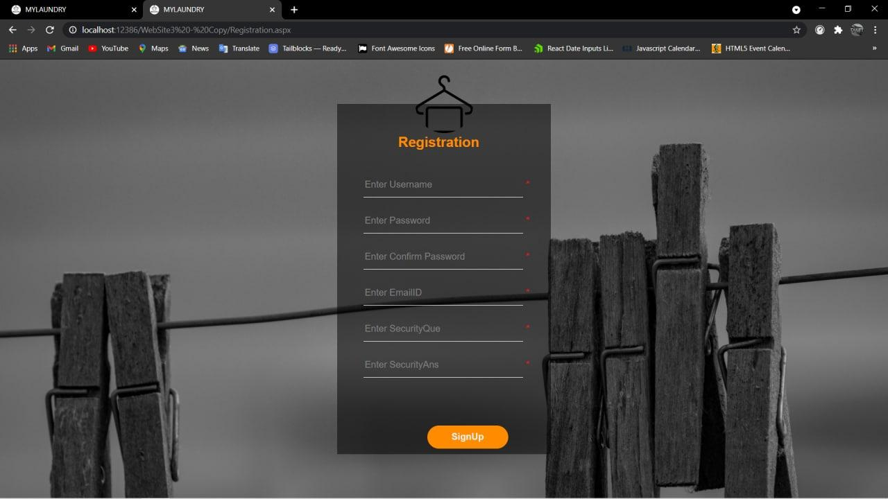
Registration Form
SLICA
6

Slide 7
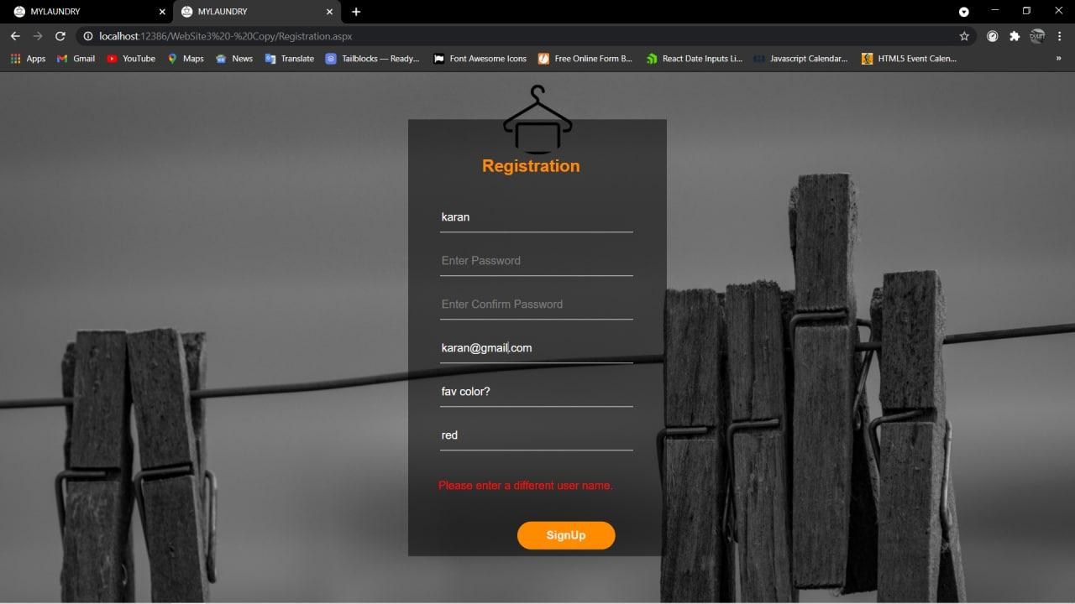
If username already exists then error is shown.
SLICA
7

Slide 8
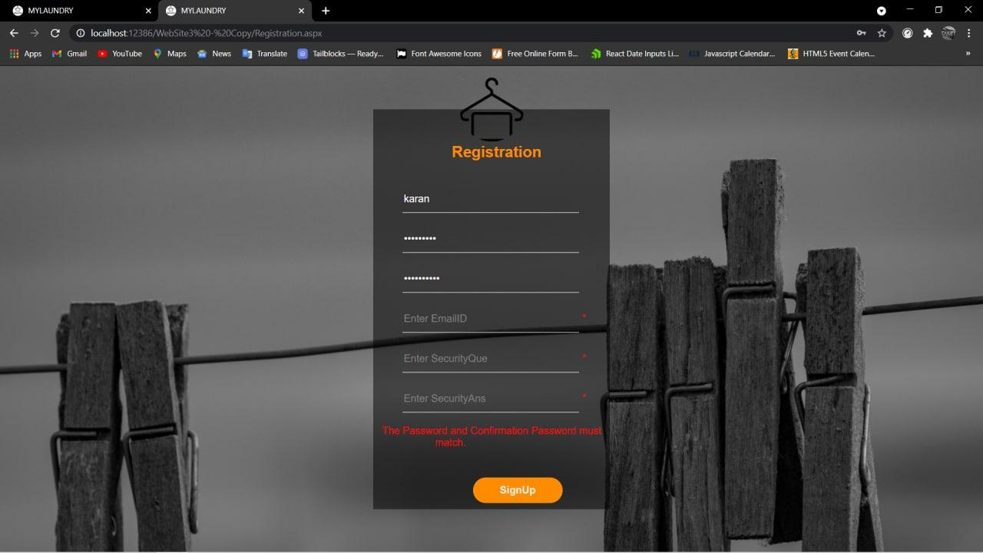
If Password and Confirm password don't match then error is shown.
SLICA
8

Slide 9
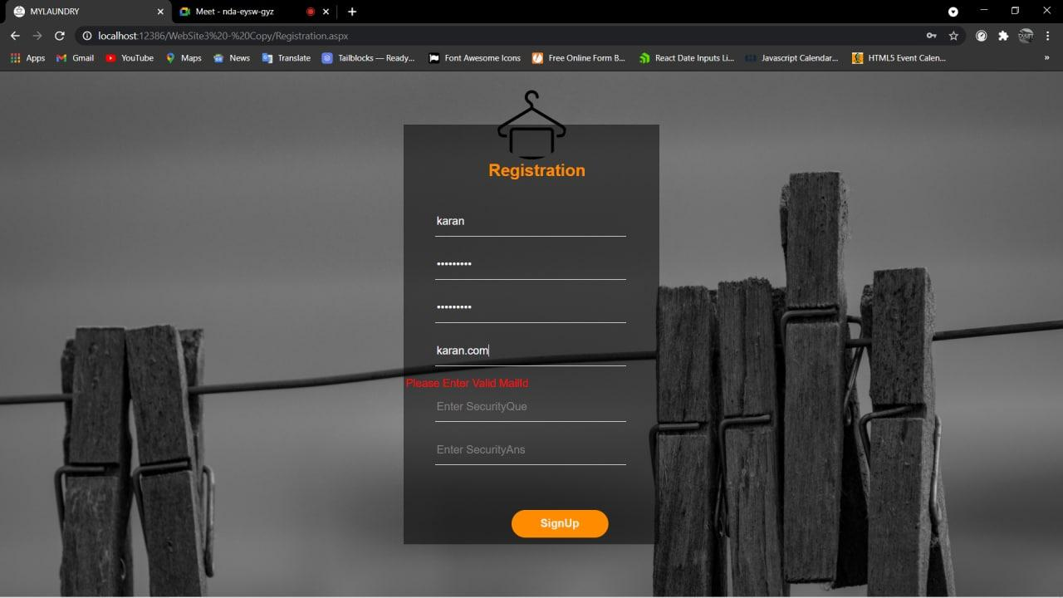
If Email-id is not in correct format then Error shown.
SLICA
9

Slide 10
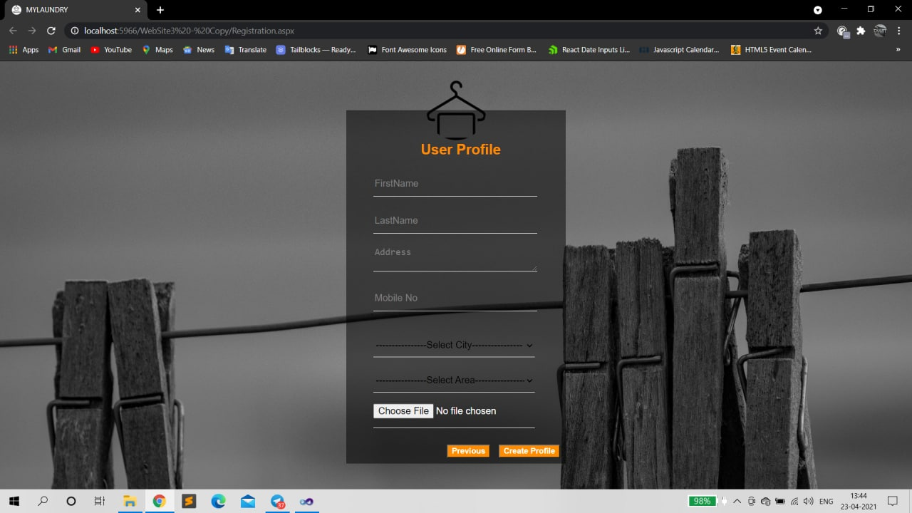
When user clicks on SignUp button then shown User Profile Form.
SLICA
10

Slide 11
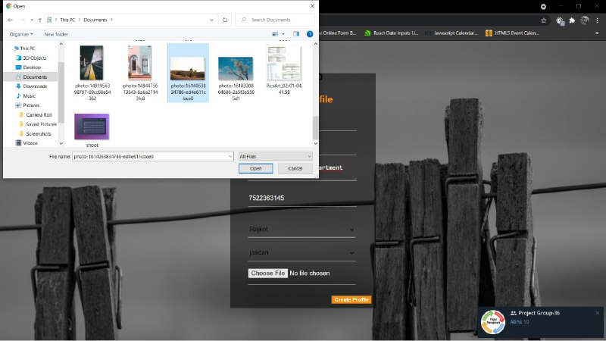
File upload control shown when User Uploads their Profile Picture.
SLICA
11

Slide 12
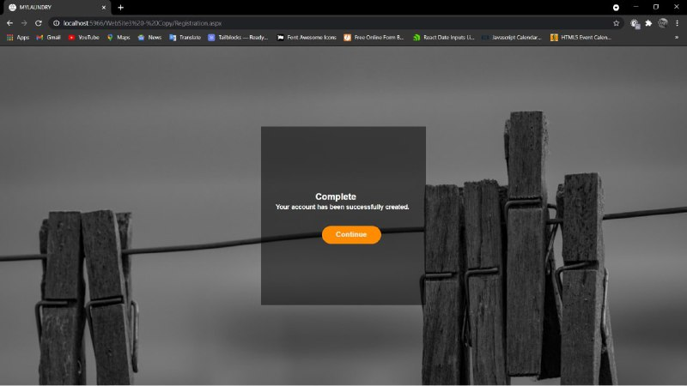
User account created successfully.
SLICA
12

Slide 13
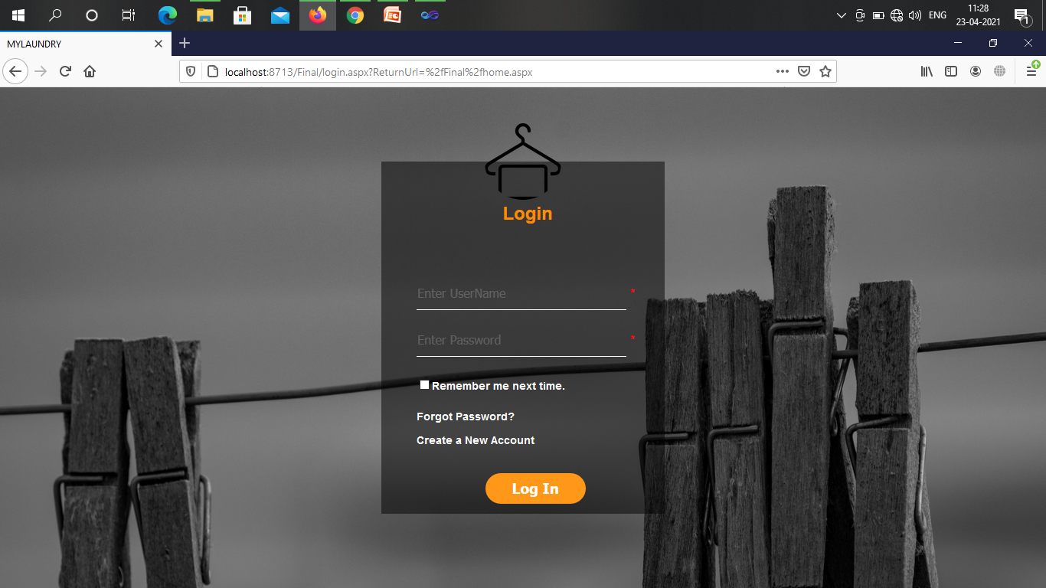
User can’t login directly without Username and password.
SLICA
13

Slide 14

If User Entering Username and not password.
SLICA
14

Slide 15

System notifies this is mandatory field.
SLICA
15

Slide 16
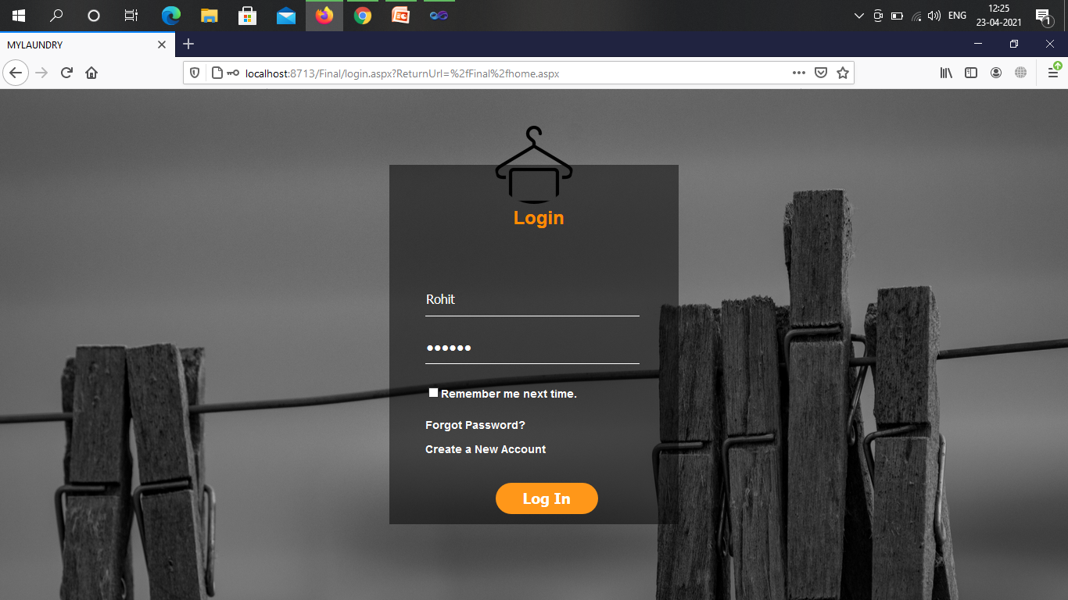
With Username and wrong password.
SLICA
16

Slide 17
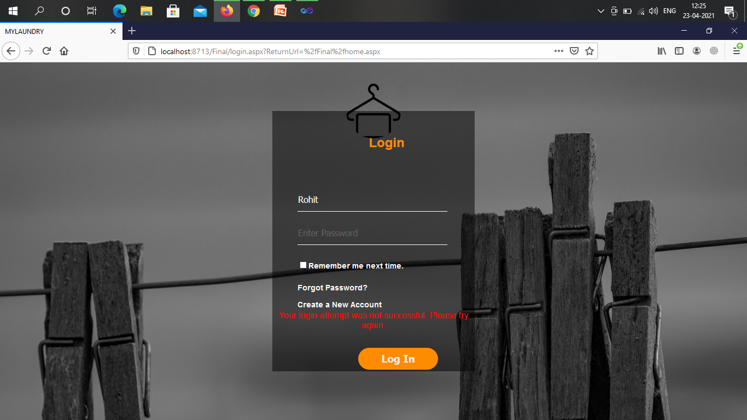
Error shown
SLICA
17

Slide 18
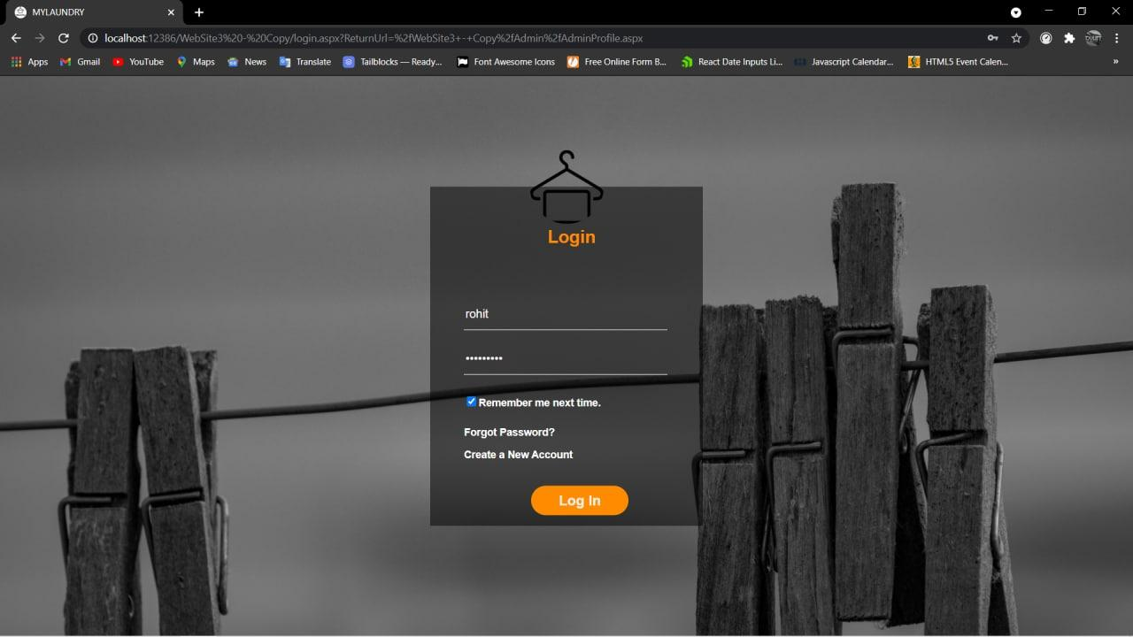
With Correct Username and password.
SLICA
18

Slide 19
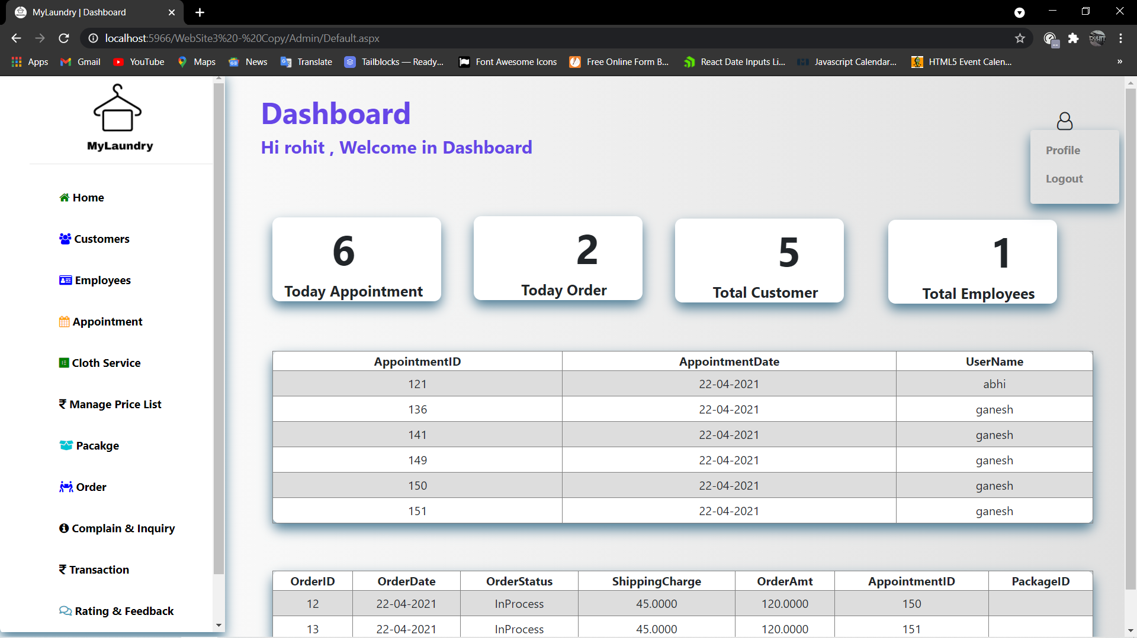
If login user is admin.
SLICA
19

Slide 20
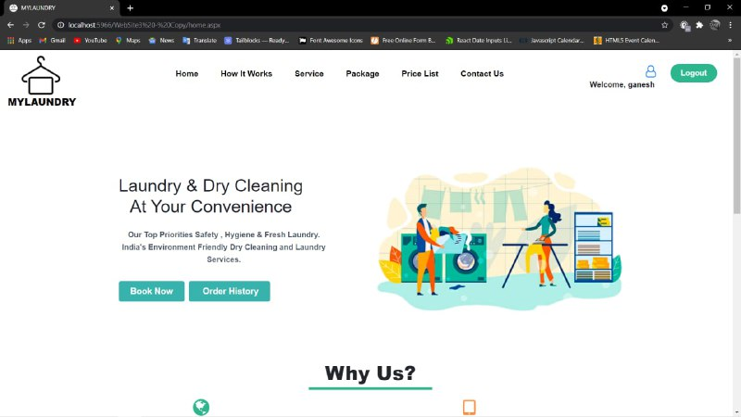
If login user is customer .
SLICA
20

Slide 21
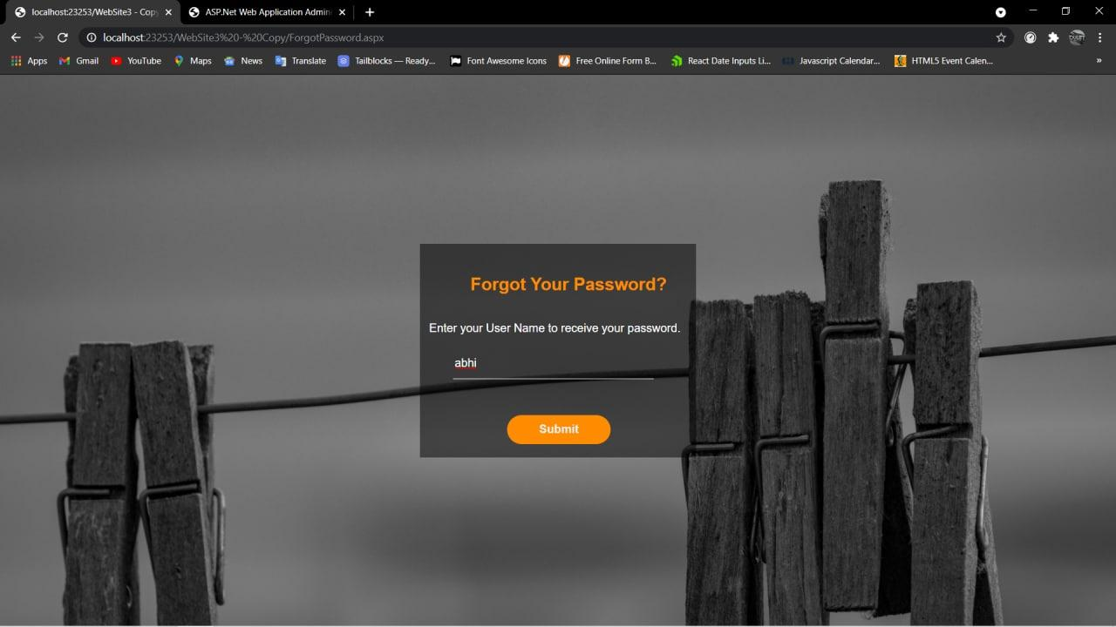
When user forgot there password.
SLICA
21

Slide 22
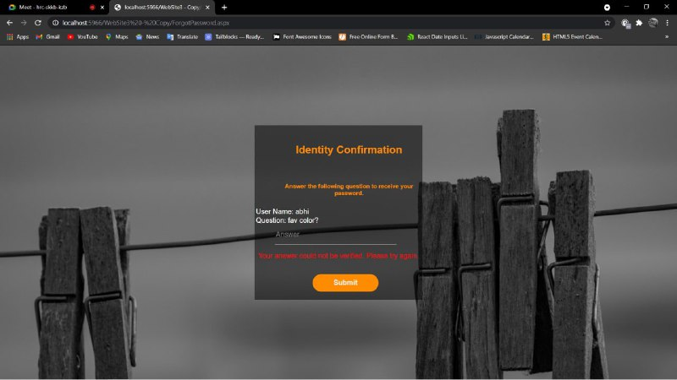
When user enter wrong security answer.
SLICA
22

Slide 23
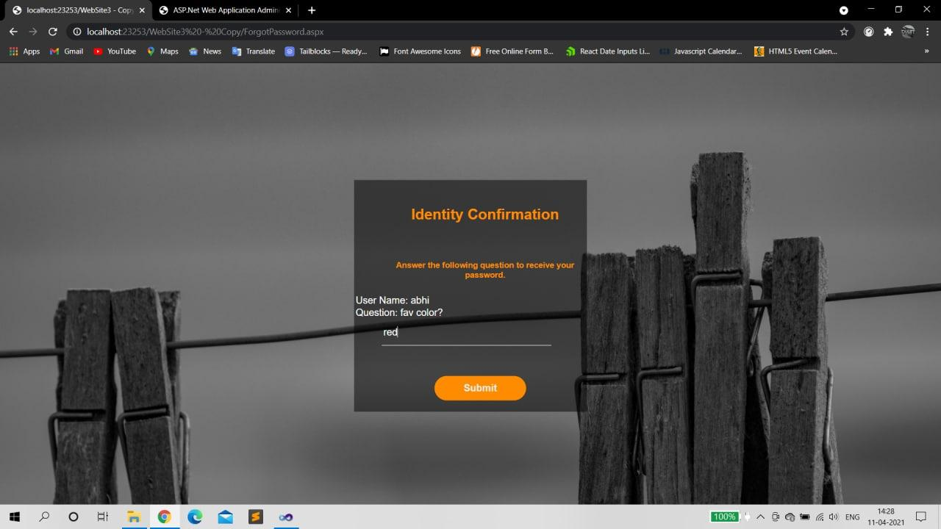
When user enter correct security answer.
SLICA
23

Slide 24
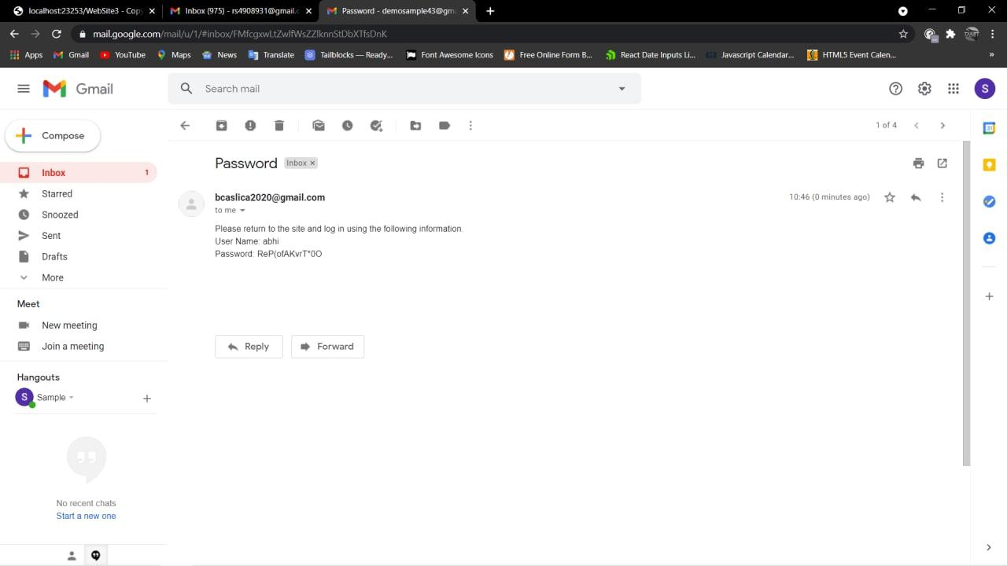
Password received on email
SLICA
24

Slide 25
Admin Panel
SLICA
25

Slide 26
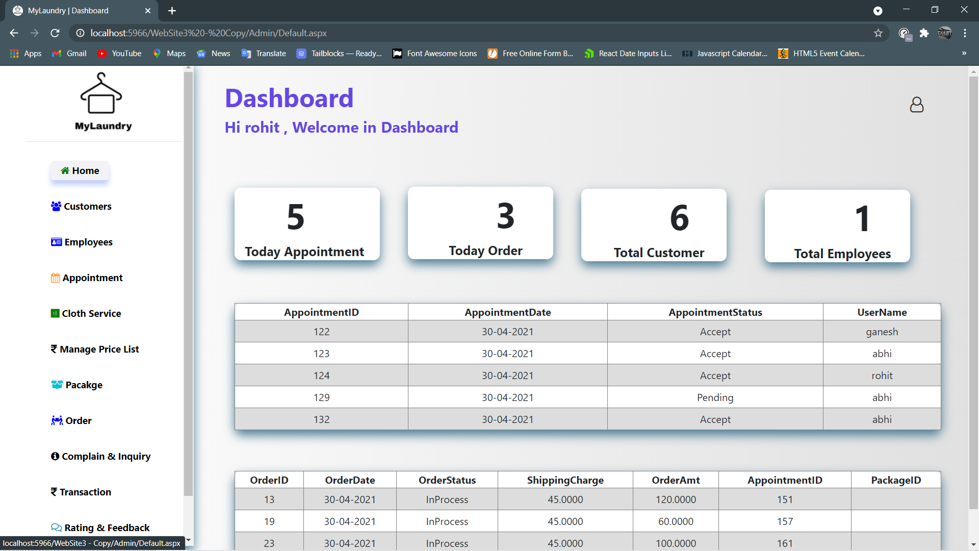
Admin’s Dashboard
SLICA
26

Slide 27
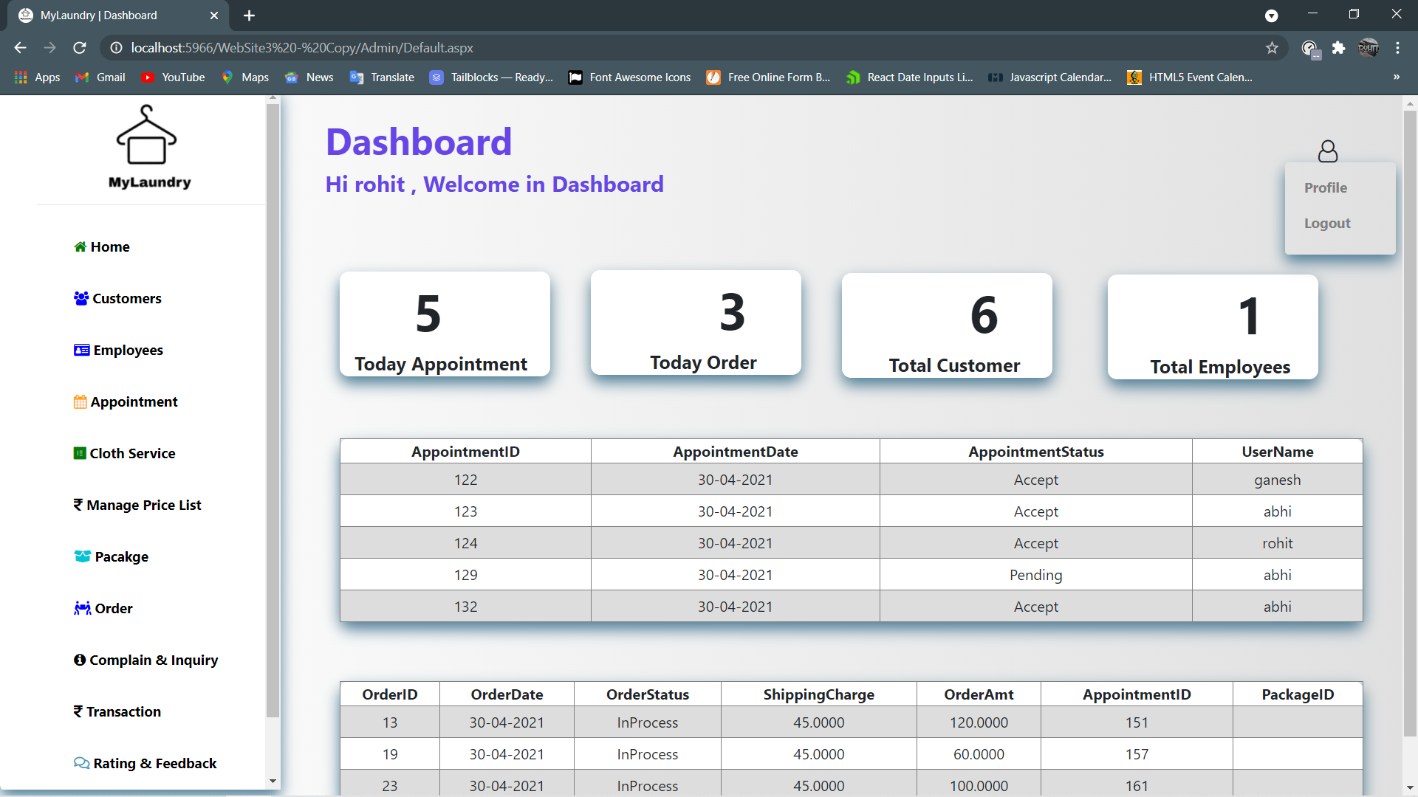
SLICA
27

Slide 28
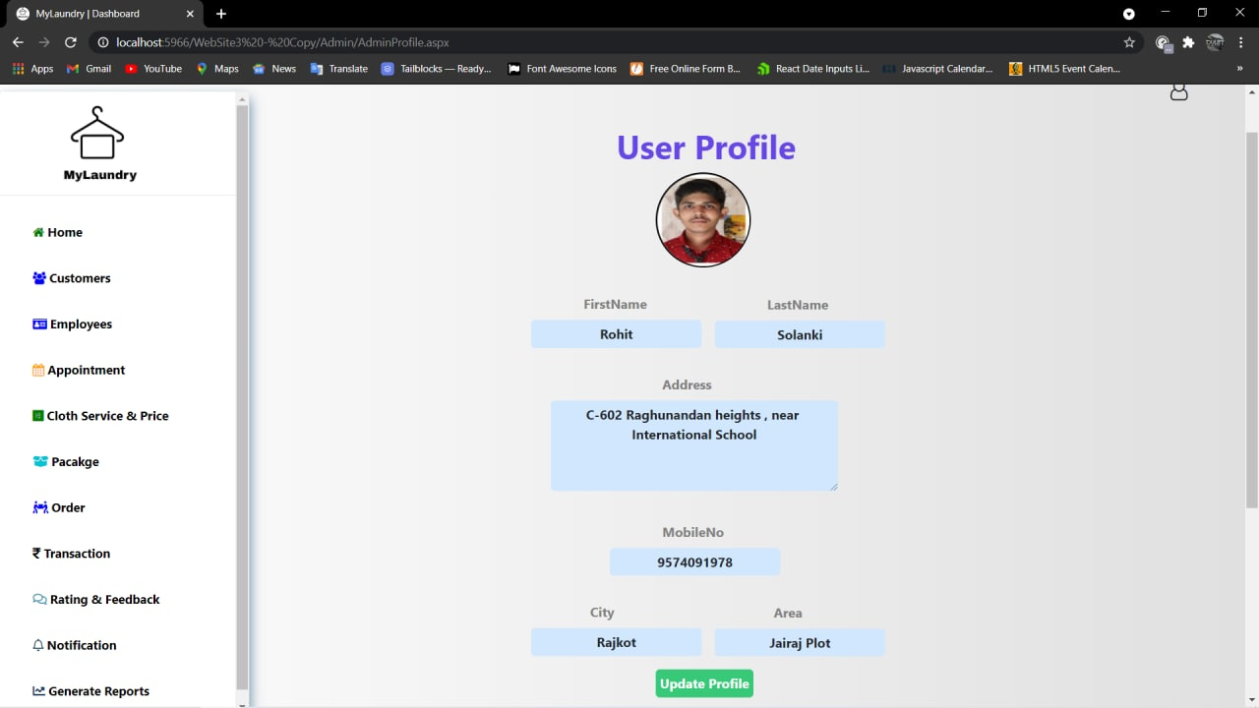
When admin wants to change any of His/Her details.
SLICA
28

Slide 29
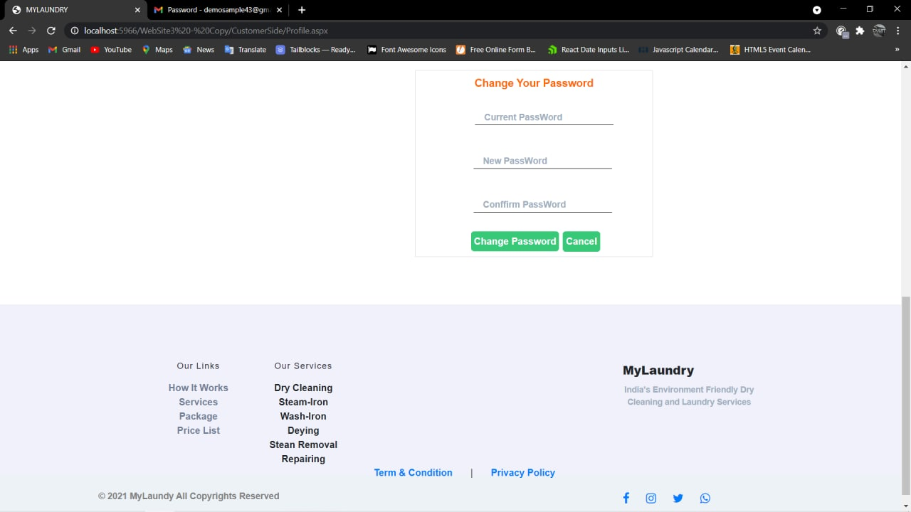
When admin wants to Change their Password
SLICA
29

Slide 30
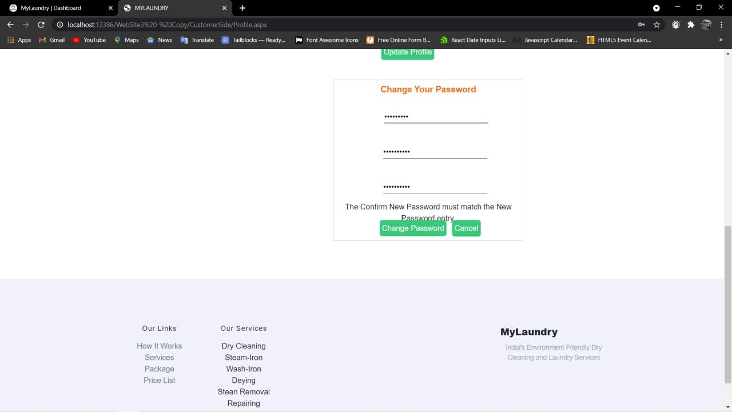
If Password and Confirm password don't match then error is shown.
SLICA
30

Slide 31
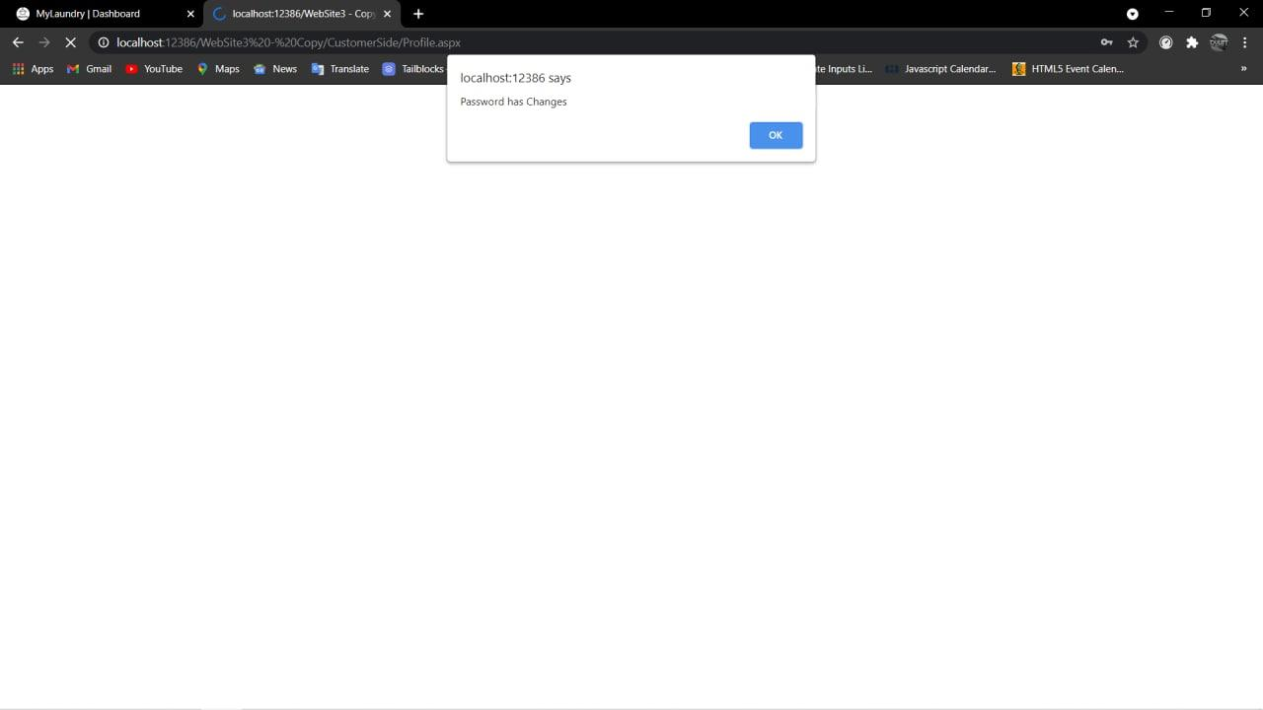
If Password and Confirm password are same, password changed successfully.
SLICA
31

Slide 32
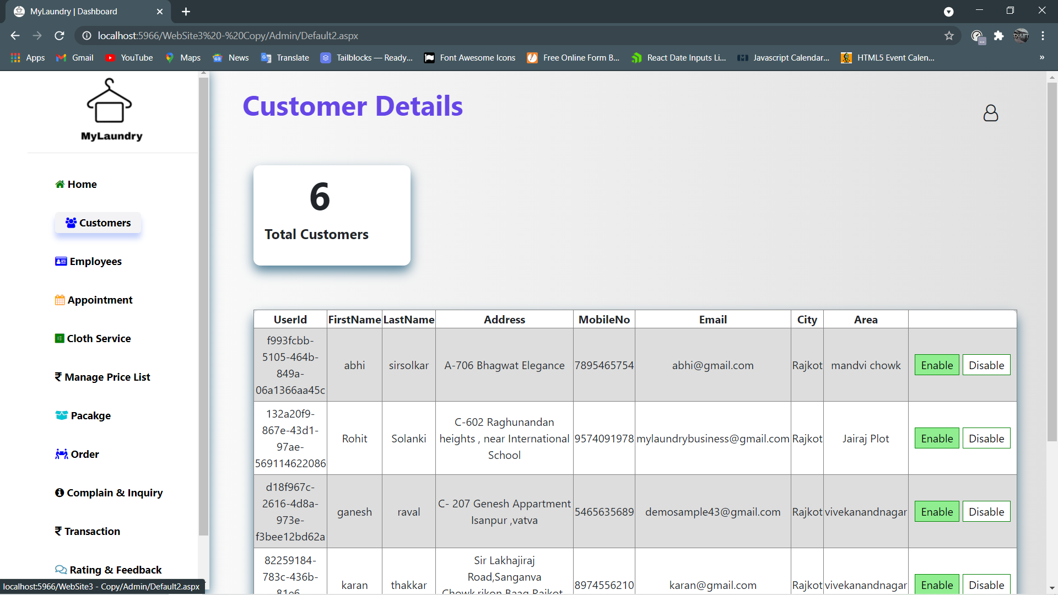
When admin clicks on Customer then admin can see customer Details.
SLICA
32

Slide 33
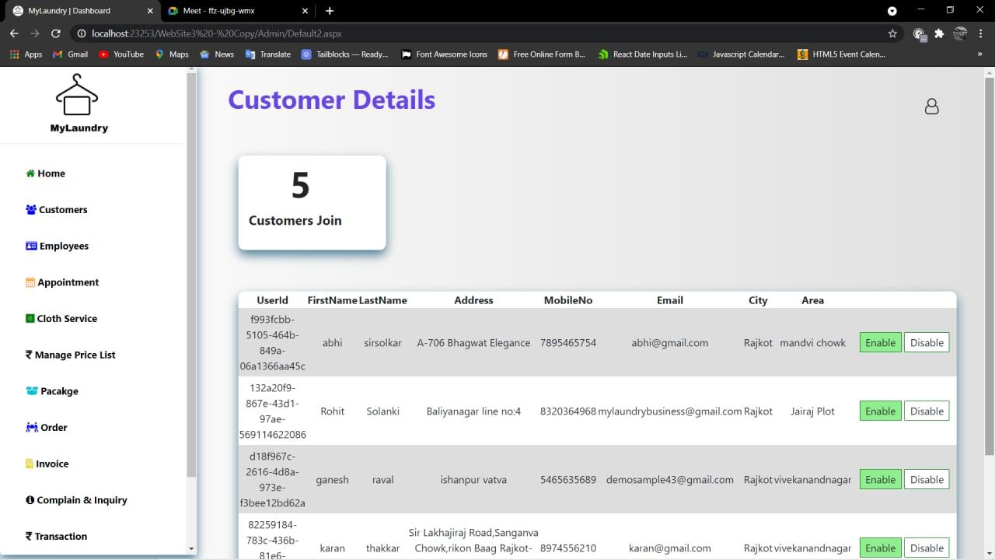
When Admin want to disable customer then they click on Disable.
SLICA
33

Slide 34
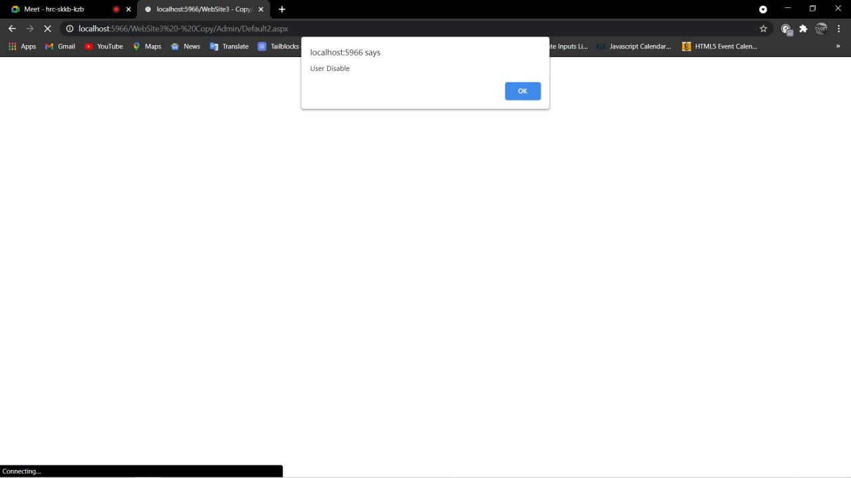
Customer Disable Successfully.
SLICA
34

Slide 35
When Admin want to Enable customer then they click on Enable.
SLICA
35

Slide 36
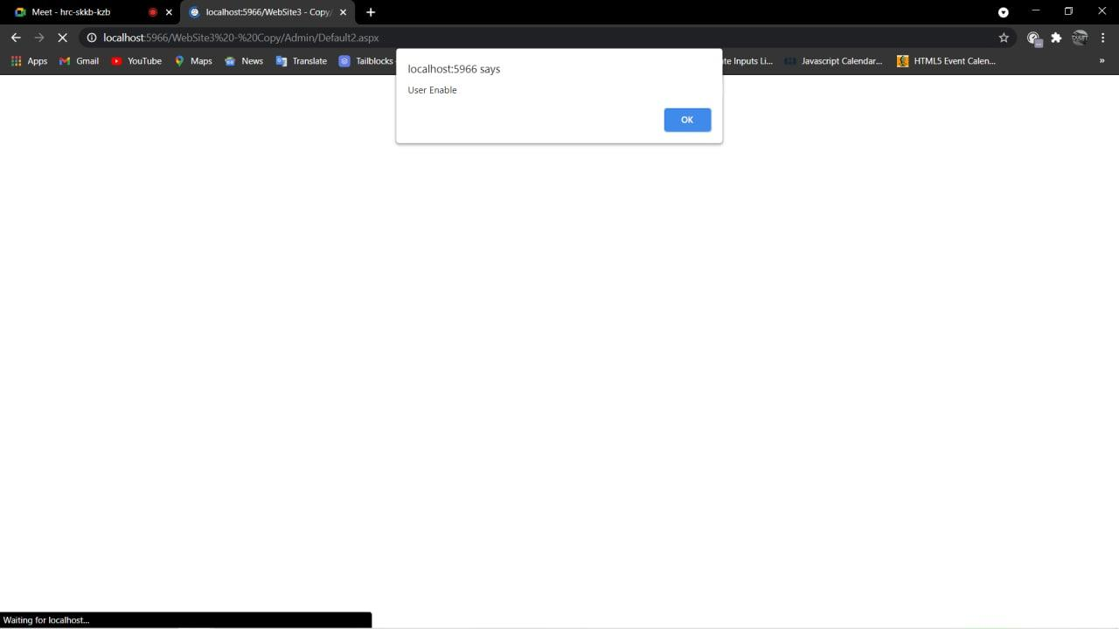
Customer Enable Successfully.
SLICA
36

Slide 37
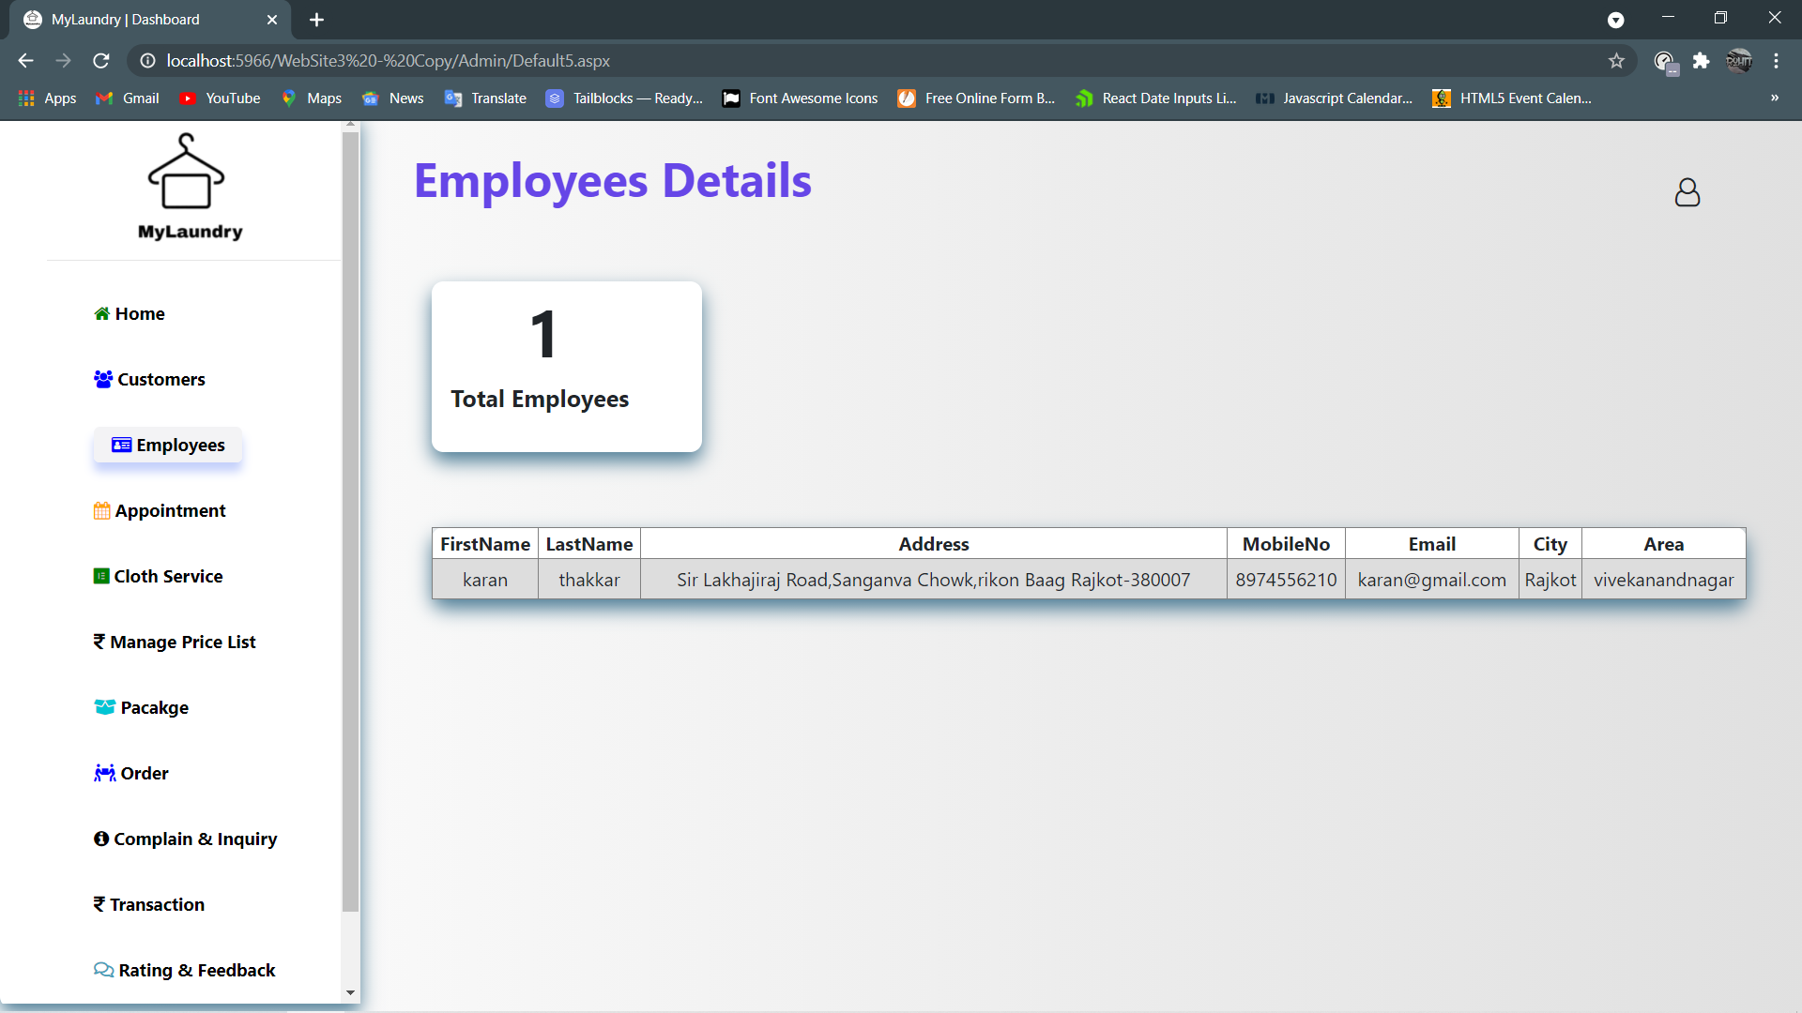
When admin clicks on Employee then admin can see Employee Details.
SLICA
37

Slide 38
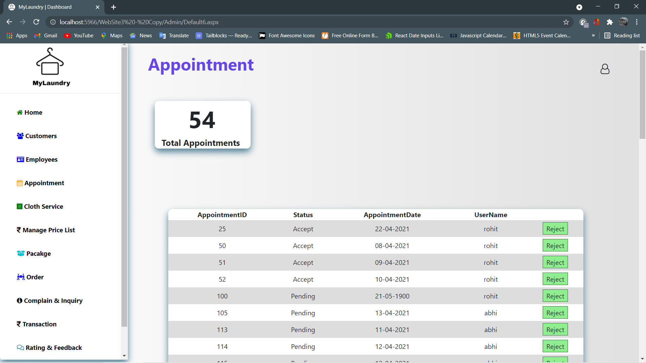
When admin clicks on Appointment then admin can see Appointment Details.
SLICA
38

Slide 39
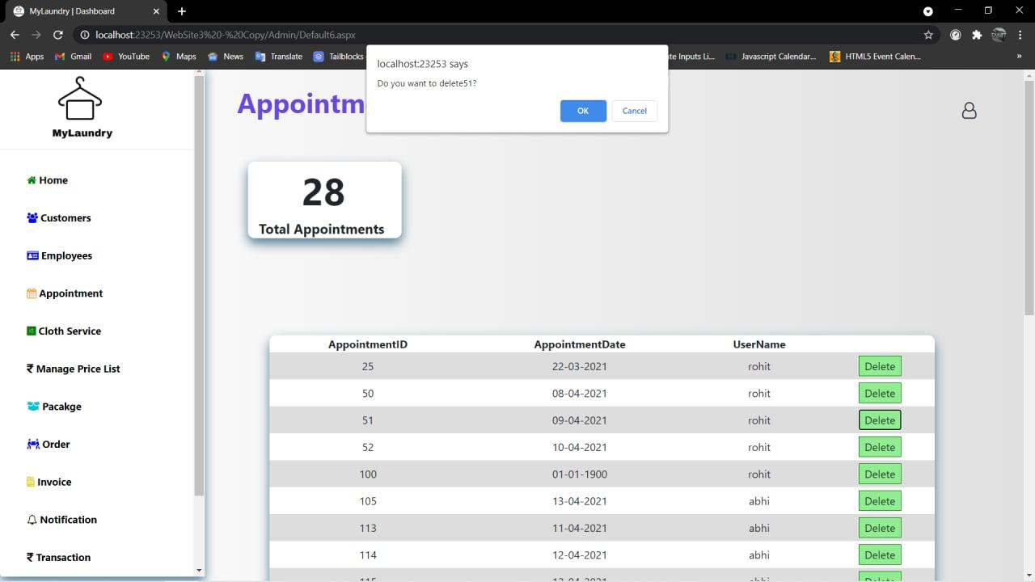
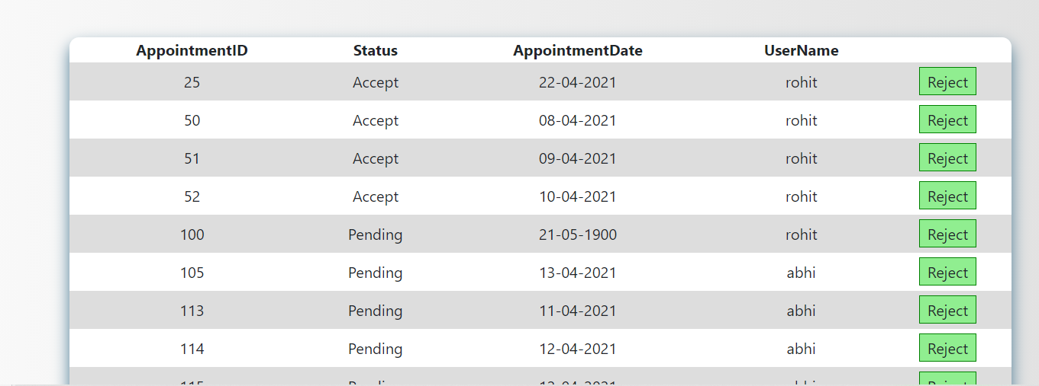
When admin clicks on Delete Appointment then customer will be notified by Mail.
SLICA
39

Slide 40
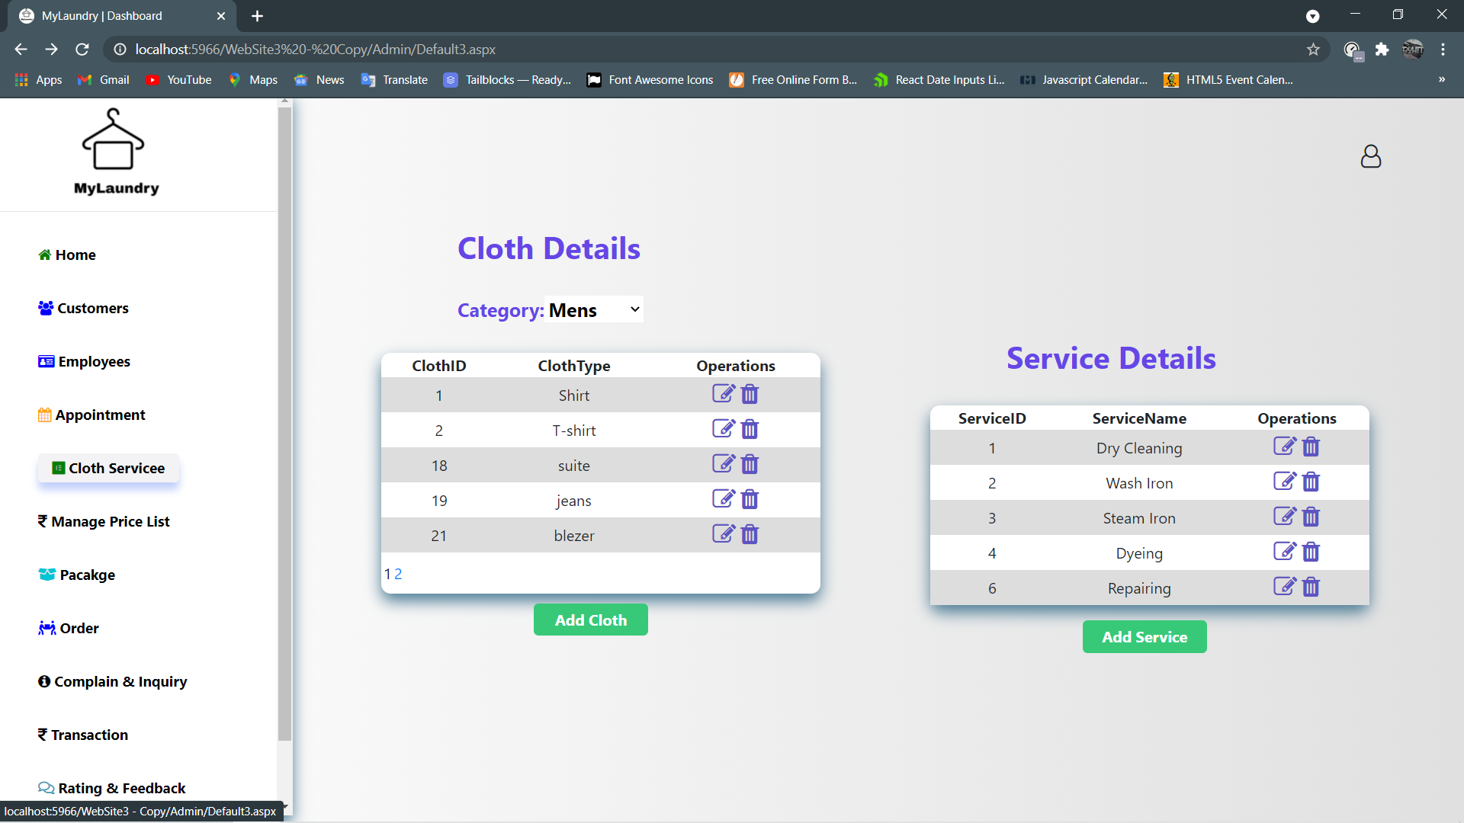
When admin clicks on Cloth Service then admin can see Cloth and Service Details.
SLICA
40

Slide 41
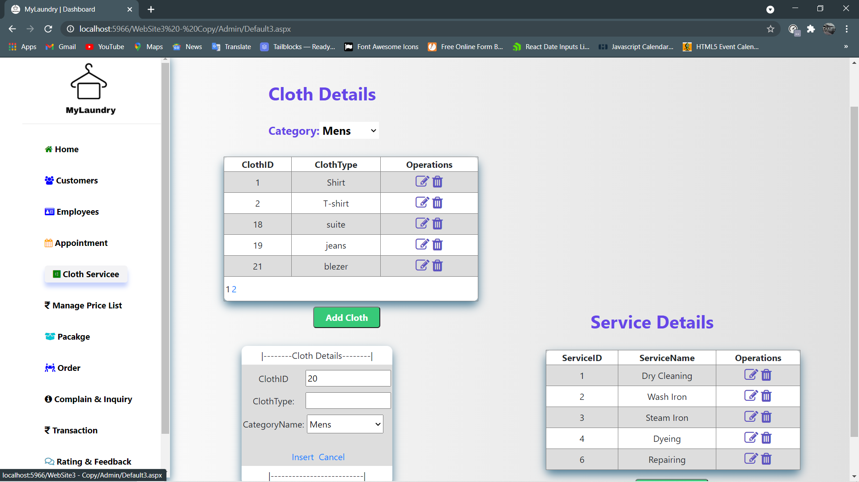
With the help of add cloth button admin can add new cloth type.
SLICA
41

Slide 42
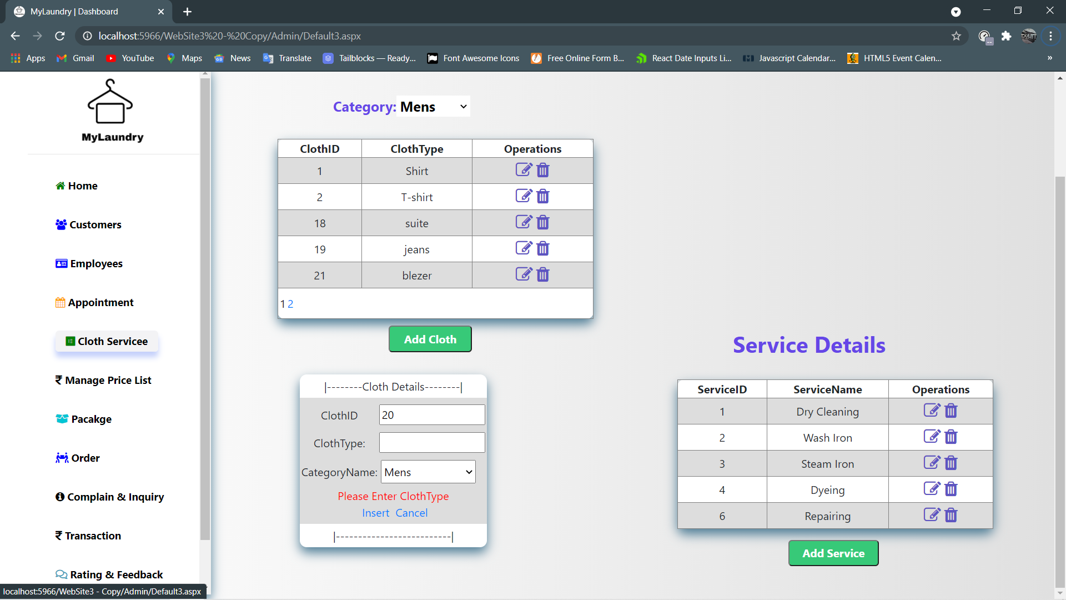
Without entering clothtype if admin clicks on insert button then error shown.
SLICA
42

Slide 43
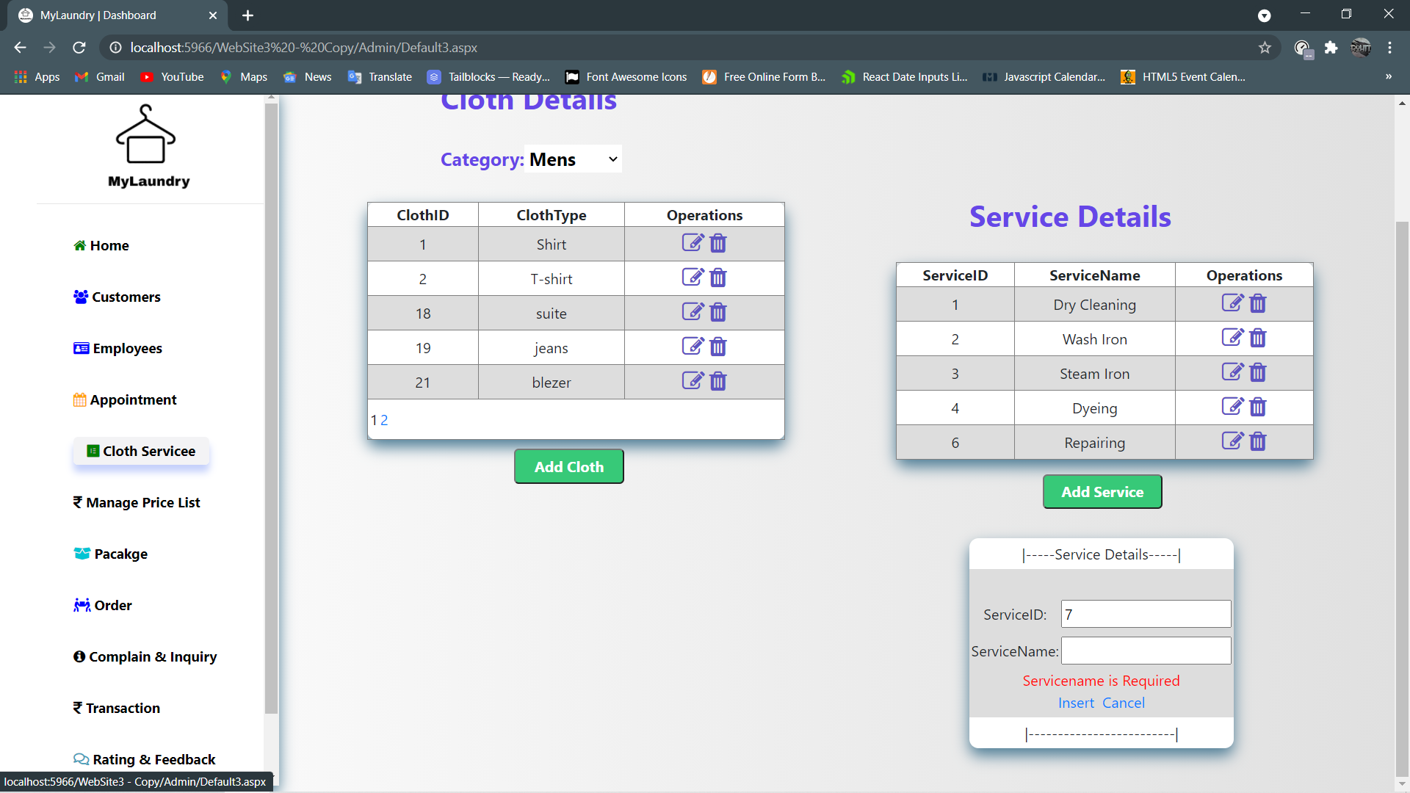
With the help of add service button admin can add new service.
SLICA
43

Slide 44
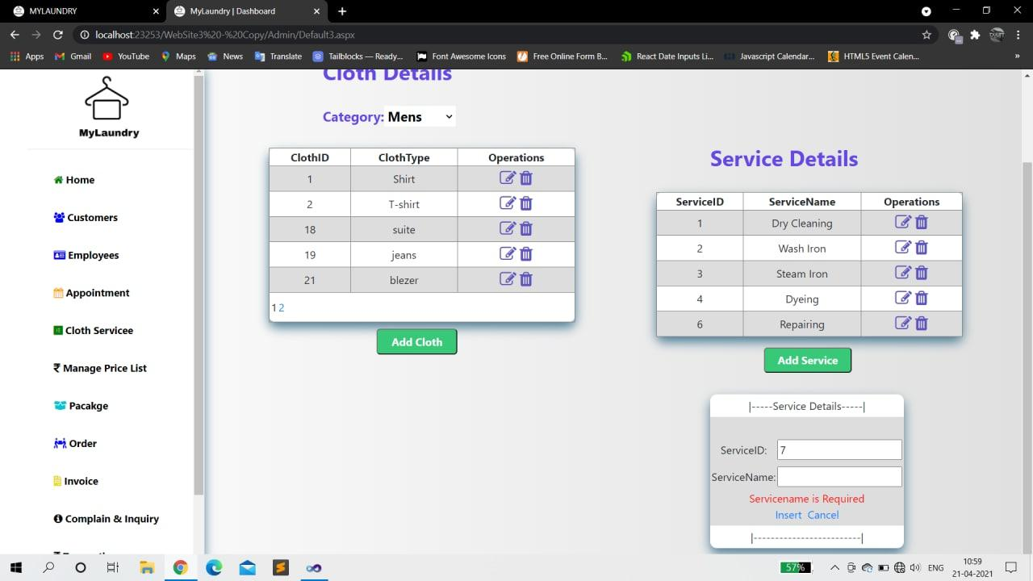
Without entering service if admin clicks on insert button then shown error.
SLICA
44

Slide 45
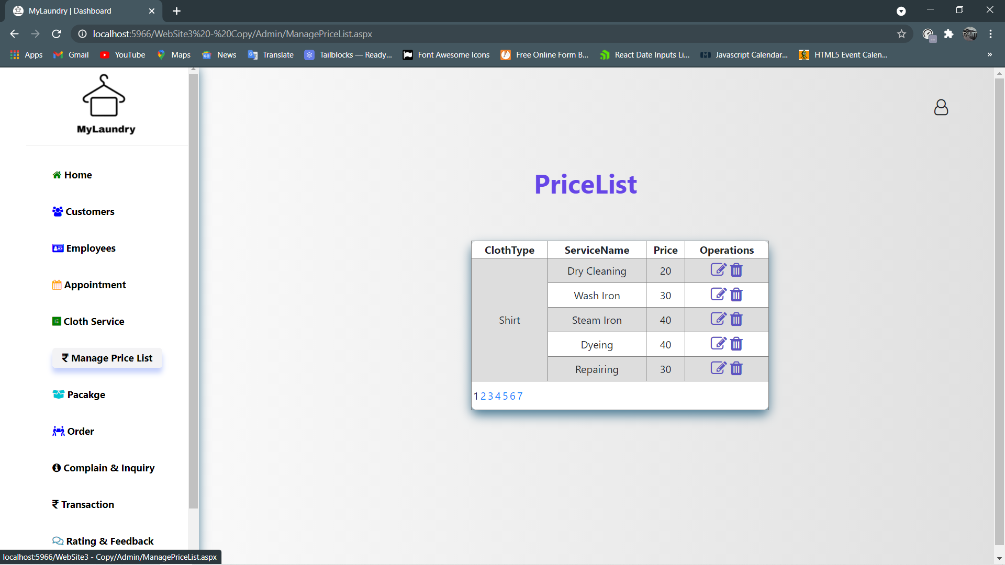
When admin clicks on price list then admin can see price details according their cloth type and service.
SLICA
45

Slide 46
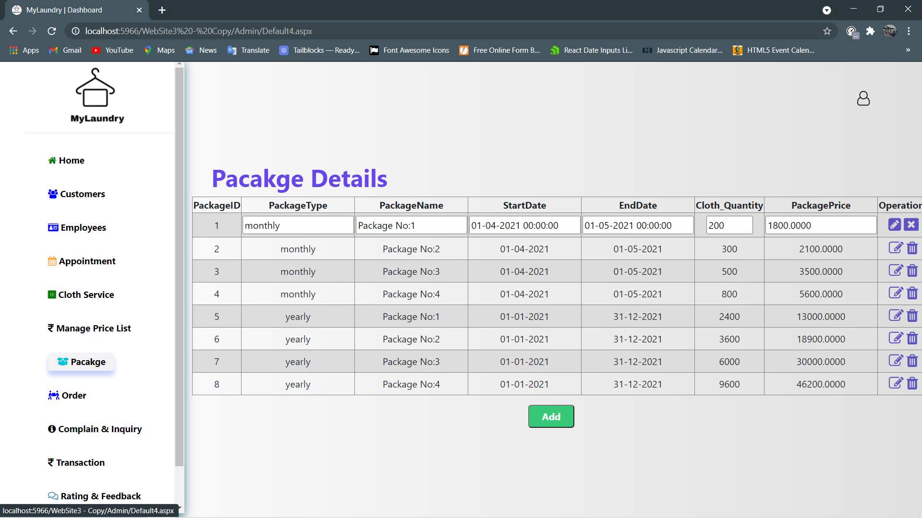
When admin clicks on Package then admin can see package Detail.
SLICA
46

Slide 47
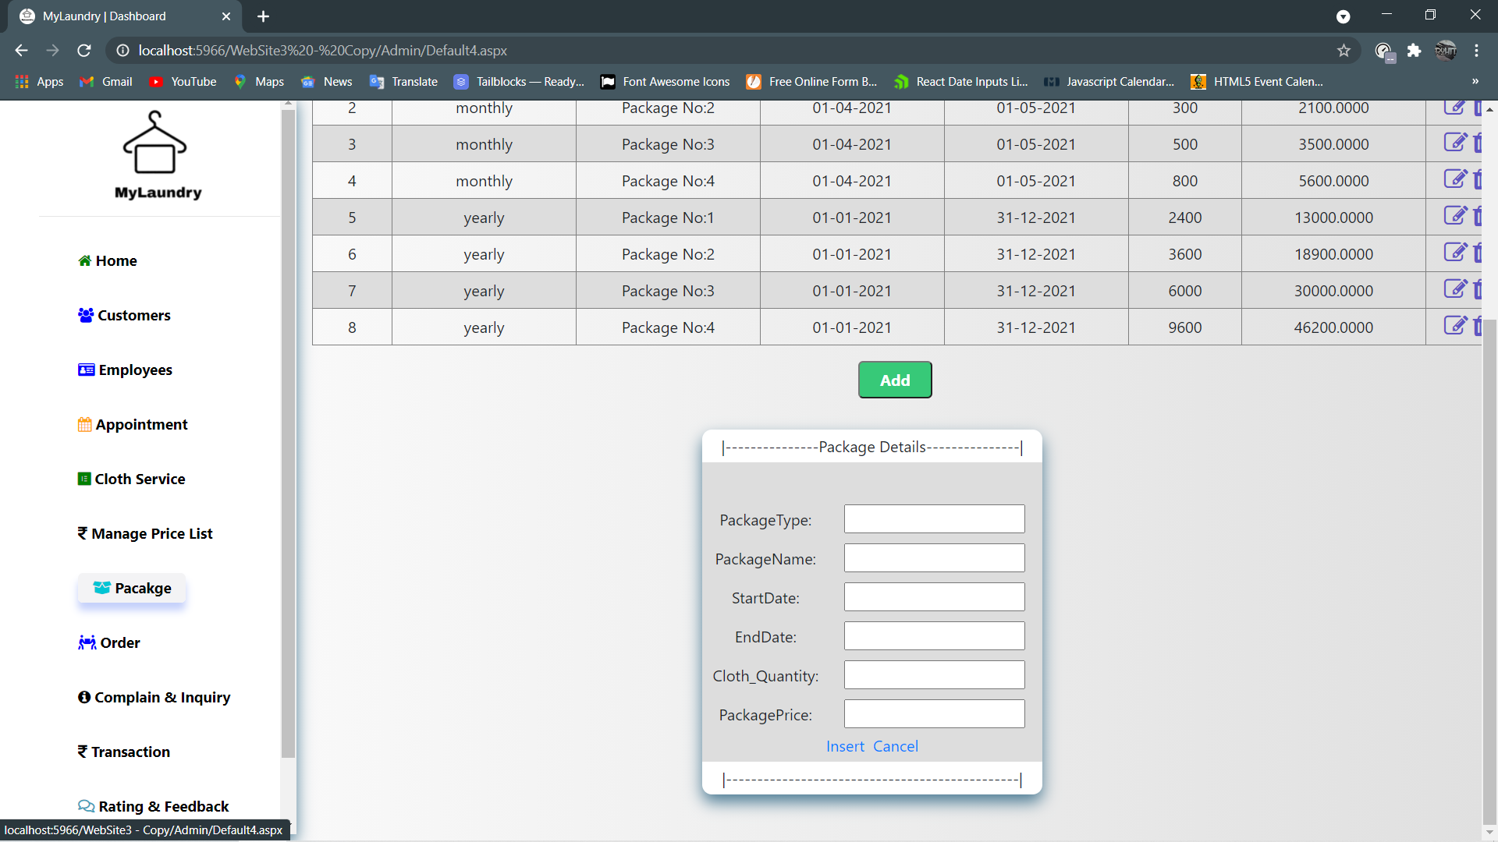
If admin wants to add new package then click on Add button.
SLICA
47

Slide 48
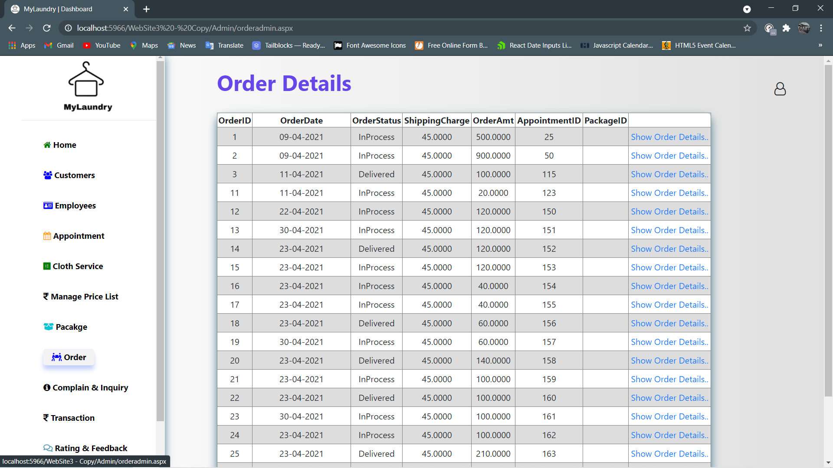
When admin clicks on Order then admin can see Order.
SLICA
48

Slide 49
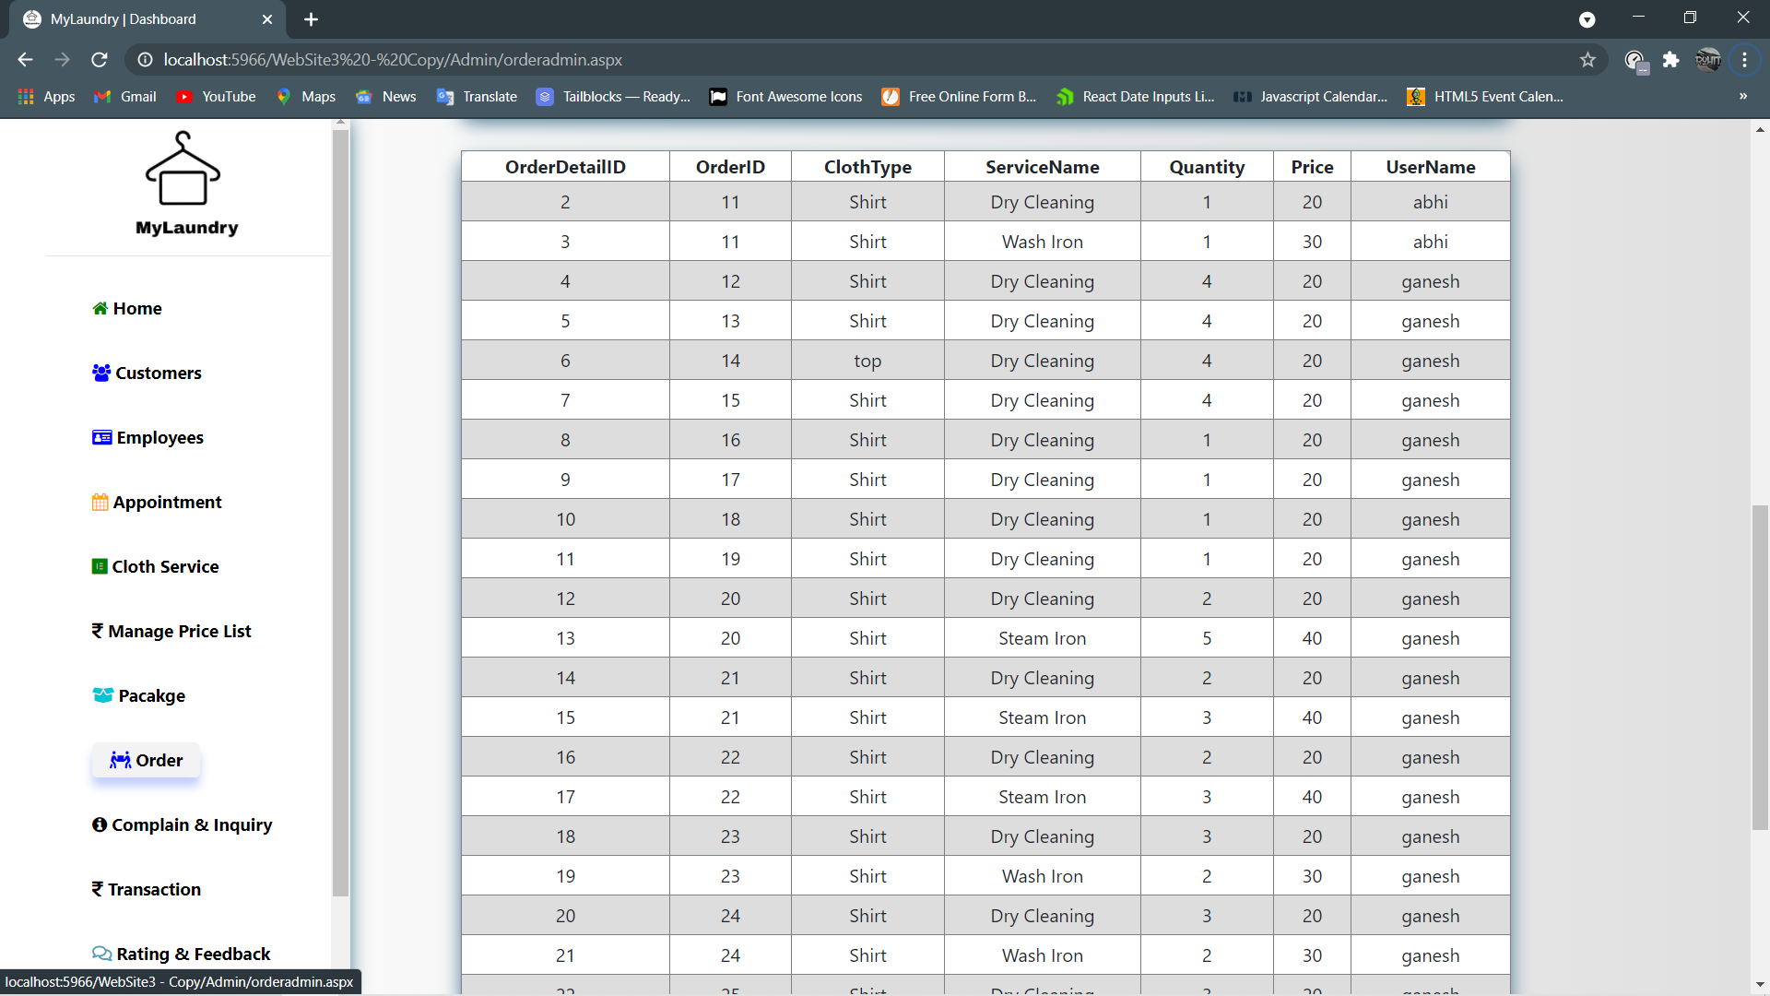
When admin click on show order details then order details are shown.
SLICA
49

Slide 50
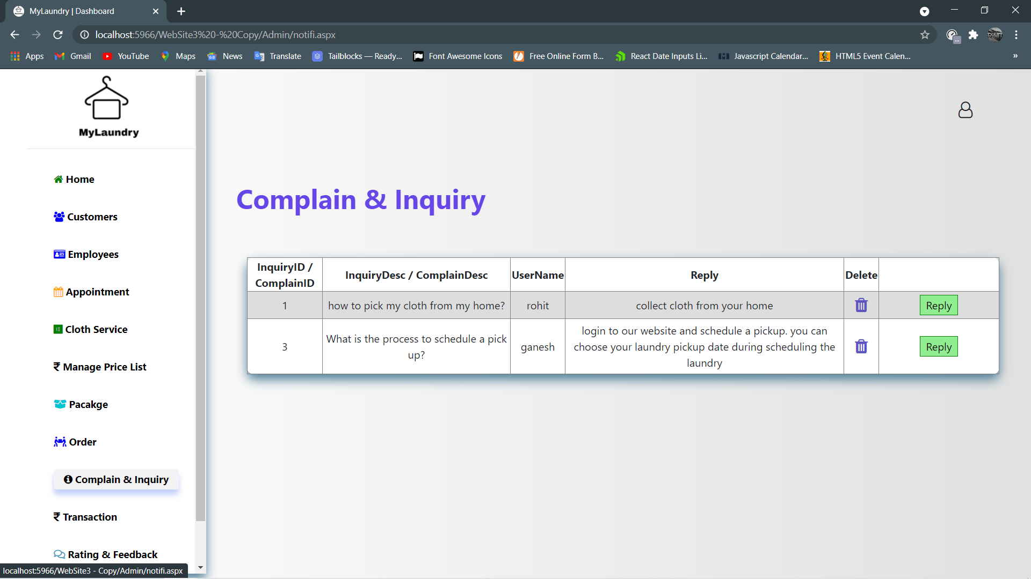
When admin clicks on Complain & Inquiry then admin can see complain & complain detail.
SLICA
50

Slide 51
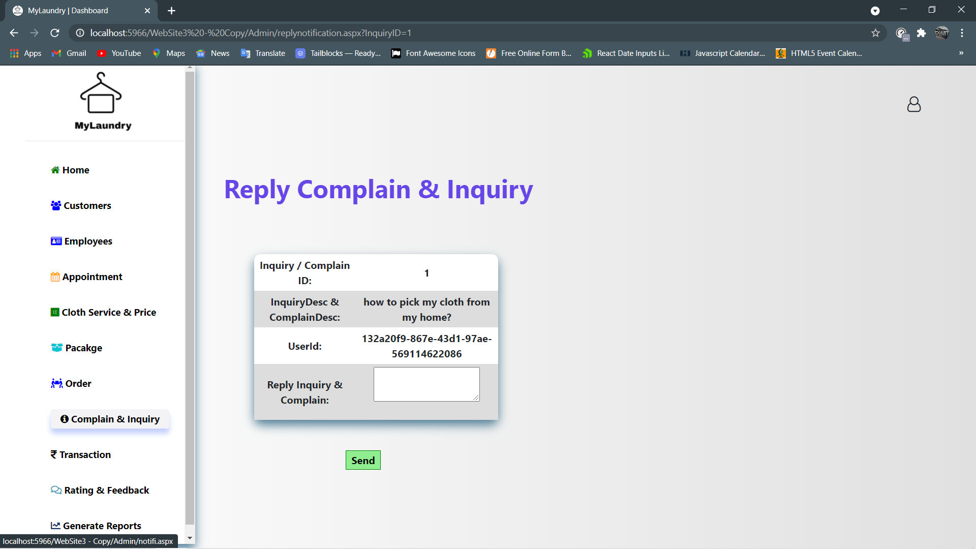
Admin can type message and click on send to reply to customer.
SLICA
51

Slide 52
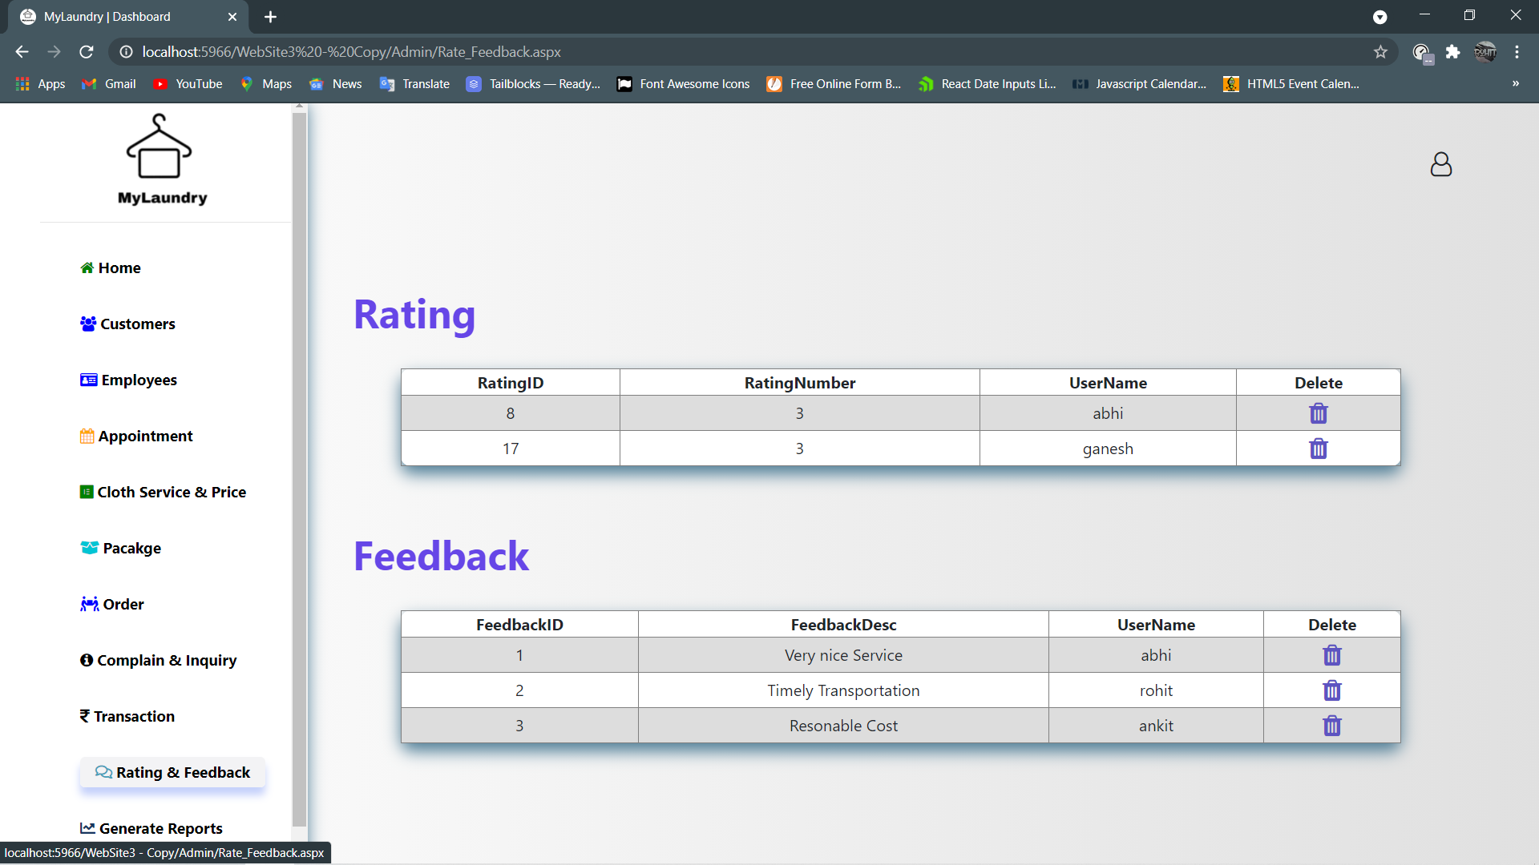
When admin clicks on Rating & Feedback then admin can see Rating & Feedback Detail.
SLICA
52

Slide 53
Customer Panel
SLICA
53

Slide 54
Customer’s Home page
SLICA
54

Slide 55
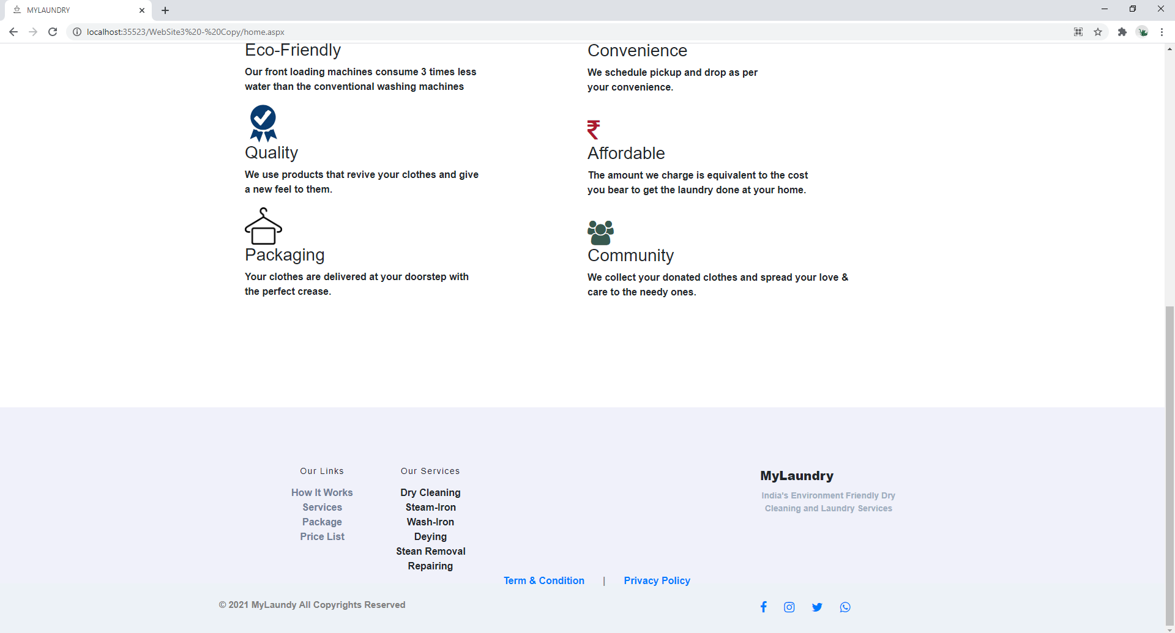
SLICA
55

Slide 56
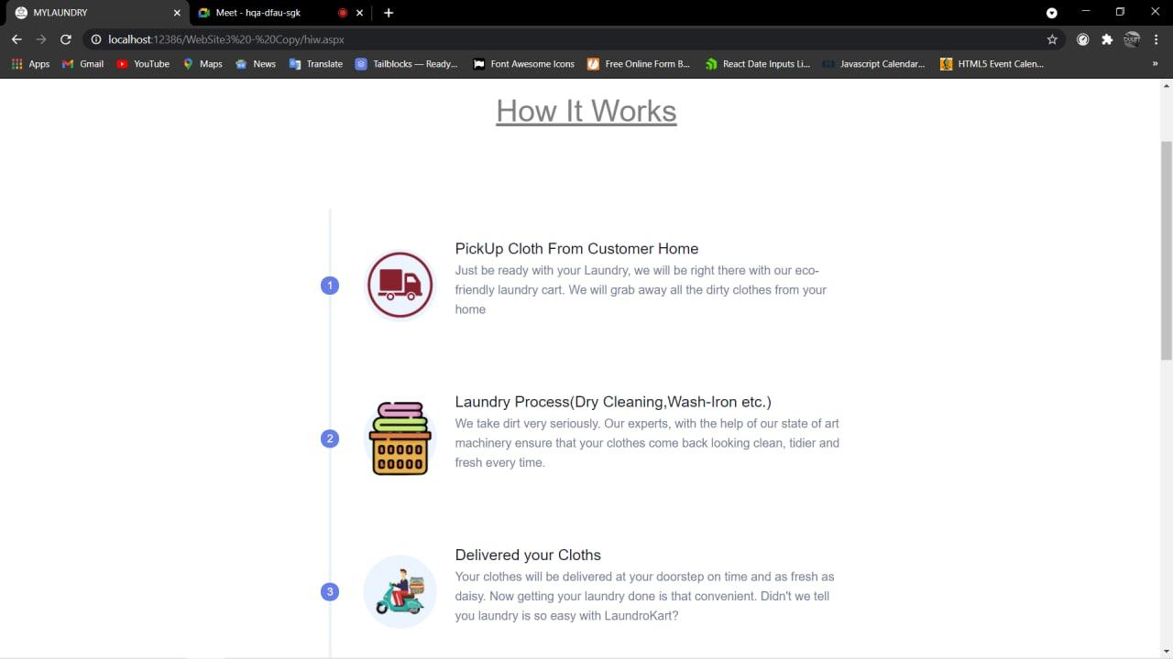
When Customer clicks on ‘How-It-Works’.
SLICA
56

Slide 57
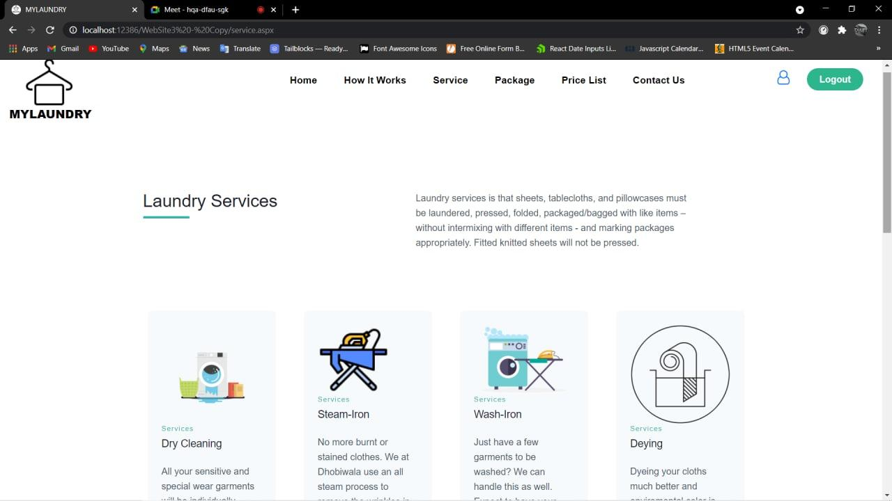
When Customer Clicks on ‘Laundry Services’
SLICA
57

Slide 58
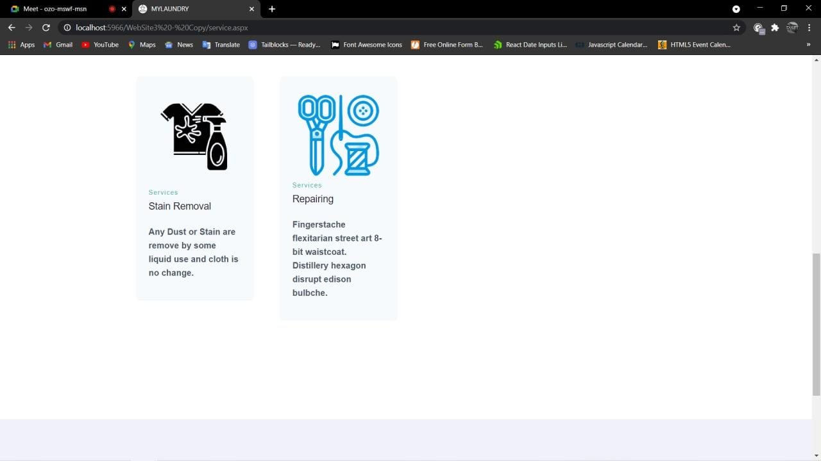
SLICA
58

Slide 59
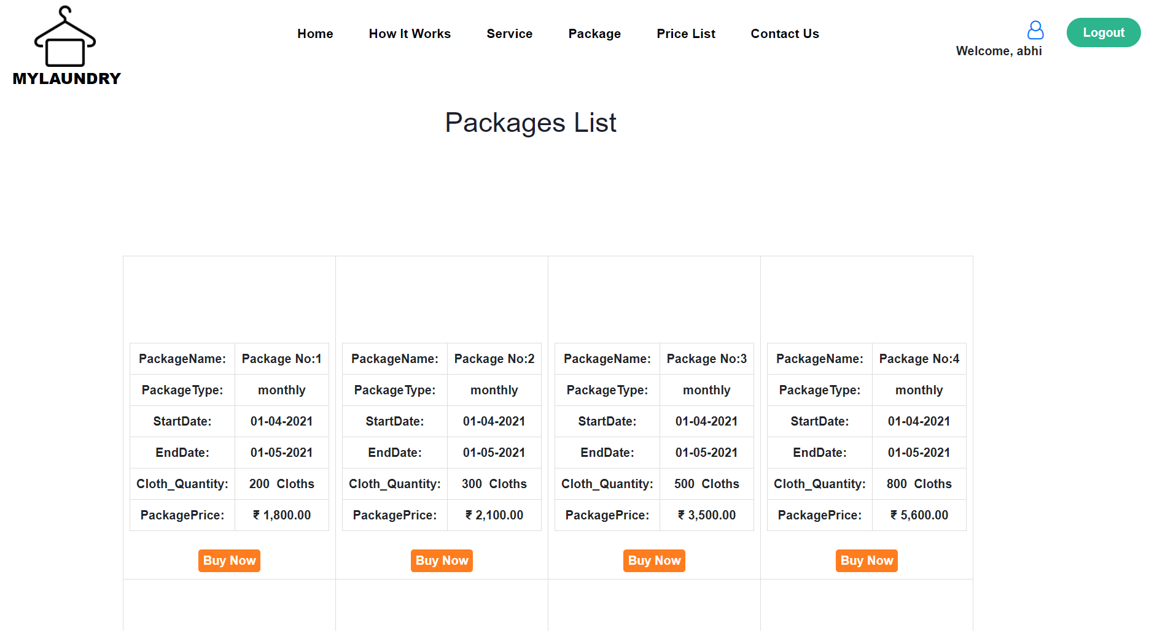
When clicked on ‘Package’ then quantity based Package details are Shown.
SLICA
59

Slide 60
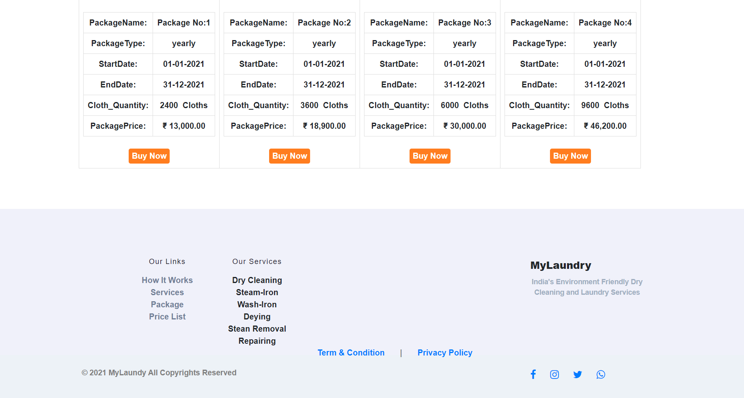
SLICA
60

Slide 61

When clicked on ‘PriceList’ then according to cloth and service, prices are shown.
SLICA
61

Slide 62

When clicked on DropDown and select ‘Women’ then accordingly women’s cloth and service price are shown.
SLICA
62

Slide 63

When customer wants to change any of their details.
SLICA
63

Slide 64
When customer wants to Change their Password
SLICA
64

Slide 65
If Password and Confirm password don't match then error shown.
SLICA
65

Slide 66
If Password and Confirm password are same then password changed successfully.
SLICA
66

Slide 67
When user clicks on Book Now.
SLICA
67

Slide 68

Appointment Form shown.
SLICA
68

Slide 69

When user clicks on Calendar Control.
SLICA
69

Slide 70

Successful Appointment Request
SLICA
70

Slide 71

Customer can delete Appointment
SLICA
71

Slide 72

When Admin Rejects customer appointment then customer receiving mail:
SLICA
72

Slide 73

Then we need to enter our details.
SLICA
73

Slide 74

When we don’t enter Quantity then error is shown.
SLICA
74

Slide 75

When we enter correct ClothType, Service and quantity then details are stored in Gridview .
SLICA
75

Slide 76

User selecting payment method.
SLICA
76

Slide 77

User want to pay through the PayU Money.
SLICA
77

Slide 78

Customer want to add their Detail.
SLICA
78

Slide 79

After that customer want to add their card detail.
SLICA
79

Slide 80

After adding customer card detail customer click on pay now.
SLICA
80

Slide 81

Customer receiving OTP.
SLICA
81

Slide 82

If the customer enter wrong OTP then transaction failed.
SLICA
82

Slide 83

If the customer enter correct OTP then transaction completed.
SLICA
83

Slide 84

Invoice displayed to user.
SLICA
84

Slide 85

When user clicks on print button then user can printout their invoice.
SLICA
85

Slide 86
When user clicks on Order History then according their orders, Order History is shown.
SLICA
86

Slide 87

Order history Displayed and when user clicks on Show order details.
SLICA
87

Slide 88

Order Details Displayed.
SLICA
88

Slide 89

If customer has any Inquiry then they type it and Send it to Admin.
SLICA
89

Slide 90

Customer’s Inquiry sent successfully.
SLICA
90

Slide 91

Admin’s reply to Customer about their inquiry.
SLICA
91

Slide 92

Customer can give Ratings and Feedback.
SLICA
92

Slide 93

SLICA
93

Slide 94

Terms & Conditions
SLICA
94

Slide 95

Privacy Policy
SLICA
95

Slide 96
Reports
SLICA
96

Slide 97

Daily Order Report
SLICA
97

Slide 98

Monthly Order Report.
SLICA
98

Slide 99

Daily Appointment Report.
SLICA
99

Slide 100

Monthly Appointment
11-04-2021
SLICA
100

Slide 101

Area wise Customer Report
SLICA
101

Slide 102

Pricelist Details Report
SLICA
102

Slide 103

Thank You
SLICA
103

